Slide 1
Unit 6
Advanced Javascript

Slide 2
Operators in Javascript
1. Arithmetic Operators
Operator | Description | Example
+ | Addition | a + b
- | Subtraction | a - b
* | Multiplication | a * b
/ | Division | a / b
% | Modulus (Remainder) | a % b
** | Exponentiation | a ** b

Slide 3
Assignment Operator
Operator | Description | Example
= | Assign | a = 5
+= | Add and assign | a += 5
-= | Subtract and assign | a -= 5
*= | Multiply and assign | a *= 5
/= | Divide and assign | a /= 5
%= | Modulus and assign | a %= 5
**= | Exponentiate and assign | a **= 2

Slide 4
Comparison Operators
Operator | Description | Example
== | Equal to (type coercion) | a == b
=== | Strict equal (no type coercion) | a === b
!= | Not equal | a != b
!== | Strict not equal | a !== b
> | Greater than | a > b
< | Less than | a < b
>= | Greater than or equal to | a >= b
<= | Less than or equal to | a <= b

Slide 5
Logical Operators
Operator | Description | Example
&& | Logical AND | a && b
` |  | `
! | Logical NOT | !a

Slide 6
Bitwise Operators
Operator | Description
& | AND
` | `
^ | XOR
~ | NOT
<< | Left shift
>> | Right shift
>>> | Zero-fill right shift

Slide 7
String Operators
Operator | Description | Example
+ | Concatenation | "Hello " + "World"
+= | Append and assign | str += " World"

Slide 8
7. Type Operators
Operator | Description | Example
typeof | Returns the type of a variable | typeof "Hello"
instanceof | Checks if an object is an instance of a class | a instanceof Array

Slide 9
1. Primitive Data Types These are immutable and represent a single value.
Data Type | Description | Example | Use Case
String | Represents textual data | "Hello" | Storing and manipulating text
Number | Represents integers and floating-point numbers | 42, 3.14 | Arithmetic, counters, scores
BigInt | For large integers beyond Number.MAX_SAFE_INTEGER | 12345678901234567890n | Cryptography, large datasets
Boolean | Represents logical values | true, false | Conditional logic, flags
undefined | Variable declared but not assigned | let a; → undefined | Checking if value is initialized
null | Intentionally no value | let user = null; | Resetting or clearing a value
Symbol | Unique and immutable value | Symbol('id') | Unique keys in objects
typeof | To check type | typeof 42 → "number" | Debugging, type checking

Slide 10
2. Non-Primitive (Reference) Data Types These are mutable and can hold collections of values or complex entities.
Data Type | Description | Example | Use Case
Object | Collection of key-value pairs | { name: "Alice", age: 25 } | Storing related data as a single unit
Array | Ordered list of values | [1, 2, 3] | Lists, queues, stacks
Function | Block of reusable code | function greet() {} | Encapsulation, reusability
Date | Represents date and time | new Date() | Timestamps, calendars
RegExp | Regular expressions for pattern matching | /abc/ | Form validation, string search

Slide 11
Switch Case

Slide 12
<!DOCTYPE html>
<html>
<body>
<h2>JavaScript switch</h2>
<p id="demo"></p>
<script>
let text;
switch (new Date().getDay()) {
case 6:
text = "Today is Saturday";
break;
case 0:
text = "Today is Sunday";
break;
default:
text = "Looking forward to the Weekend";
}
document.getElementById("demo").innerHTML = text;
</script>
</body>
</html>
Default Statement

Slide 13
Combining Two Switch Cases
<script>
let text;
switch (new Date().getDay()) {
case 4:
case 5:
text = "Soon it is Weekend";
break;
case 0:
case 6:
text = "It is Weekend";
break;
default:
text = "Looking forward to the Weekend";
}

Slide 14
<!DOCTYPE html>
<html>
<body>
<input type="text" id="myText" value="Some text...">
<button onclick="myFunction()">Try it</button>
<p id="demo"></p>
<script>
function myFunction() {
var x = document.getElementById("myText").value;
document.getElementById("demo").innerHTML = x;
}
</script>
</body>
</html>
Taking Value from different Elements

Slide 15
If Else
Script
<!DOCTYPE html>
<html>
<head> <script: shown on the left >
</head>
<body>
<h2>Check Even or Odd</h2>
<label>Enter a number: </label>
<input type="number" id="numberInput">
<button onclick="checkEvenOdd()">Check</button>
</body>
</html>
<script>
function checkEvenOdd() {
let num = document.getElementById("numberInput").value;
num = parseInt(num);
if (num % 2 === 0) {
document.write(num + " is Even");
} else {
document.write(num + " is Odd");
}
}
</script>

Slide 16
If- else if - else
<script>
function checkNumber() {
let num = parseFloat(document.getElementById("numberInput").value);
if (num > 0) {
document.write(num + " is Positive");
} else if (num < 0) {
document.write(num + " is Negative");
} else {
document.write("The number is Zero");
}
}
</script>

Slide 17
Two conditions
if (num >= 10 && num <= 100) {
document.write(num + " is between 10 and 100");
} else {
document.write(num + " is NOT between 10 and 100");
}
}

Slide 18
For Loop
<!DOCTYPE html>
<html>
<head>
<title>For Loop Example</title>
<script> ---shown in next slide
</head>
<body>
<h2>Print Numbers Using For Loop</h2>
<label>Enter a number: </label>
<input type="number" id="numInput" min="1">
<button onclick="printNumbers()">Print</button>
</body>
</html>

Slide 19
For Loop Example
<script>
function printNumbers() {
let num = document.getElementById("numInput").value;
num = parseInt(num);
for (let i = 1; i <= num; i++) {
document.write(i + "<br>");
}
}
</script>

Slide 20
While loop
script
<!DOCTYPE html>
<html>
<head> <script: shown on the left >
</head>
<body>
<h2>Print Numbers Using While Loop</h2>
<label>Enter a number: </label>
<input type="number" id="numInput">
<button onclick="printNumbers()">Print</button>
</body>
</html>
<script>
function printNumbers() {
let num = parseInt(document.getElementById("numInput").value);
let i = 1;
document.write("<h3>Output:</h3>");
while (i <= num) {
document.write(i + "<br>");
i++;
}
}
</script>

Slide 21
Do- while
script
html
<!DOCTYPE html>
<html>
<head>
<script: shown on the left >
</head>
<body>
<h2>Print Numbers Using Do...While Loop</h2>
<label>Enter a number: </label>
<input type="number" id="numInput">
<button onclick="printNumbers()">Print</button>
</body>
</html>
<script>
function printNumbers() {
let num = parseInt(document.getElementById("numInput").value);
let i = 1;
document.write("<h3>Output:</h3>");
do {
document.write(i + "<br>");
i++;
} while (i <= num);
}
</script>

Slide 22
Accessing Values from various Elements

Slide 23
Month
<!DOCTYPE html>
<html>
<body>
<h3>A demonstration of how to access a Month field</h3>
<input type="month" id="myMonth" value="2014-05">
<p>Click the button to get the month and year of the month field.</p>
<button onclick="myFunction()">Try it</button>
<p><strong>Note:</strong> input elements with type="month" do not show as any date field/calendar in Firefox.</p>
<p id="demo"></p>
<script>
function myFunction() {
var x = document.getElementById("myMonth").value;
document.getElementById("demo").innerHTML = x;
}
</script>
</body>
</html>

Slide 24
Field Set
<!DOCTYPE html>
<html>
<body>
<h3>A demonstration of how to access a LEGEND element</h3>
<fieldset>
<legend id="myLegend">Personalia:</legend>
Name: <input type="text">
</fieldset>
<p>Click the button to get the text of the legend element.</p>
<button onclick="myFunction()">Try it</button>
<p id="demo"></p>
<script>
function myFunction() {
var x = document.getElementById("myLegend").innerHTML;
document.getElementById("demo").innerHTML = x;
}
</script
</body>
</html>

Slide 25
Password
<!DOCTYPE html>
<html>
<body>
Password: <input type="password" id="myPsw" value="psw123">
<p>Click the button to get the password of the password field.</p>
<button onclick="myFunction()">Try it</button>
<p id="demo"></p>
<script>
function myFunction() {
var x = document.getElementById("myPsw").value;
document.getElementById("demo").innerHTML = x;
}
</script>
</body>
</html>

Slide 26
Range
<!DOCTYPE html>
<html>
<body>
<input type="range" id="myRange" value="90">
<p>Click the button to get the value of the slider control.</p>
<button onclick="myFunction()">Try it</button>
<p id="demo"></p>
<script>
function myFunction() {
var x = document.getElementById("myRange").value;
document.getElementById("demo").innerHTML = x;
}
</script>
</body>
</html>

Slide 27
Time
<!DOCTYPE html>
<html>
<body>
<h3>A demonstration of how to access a Time field</h3>
<input type="time" id="myTime" value="22:15:00">
<p>Click the button to get the time of the time field.</p>
<button onclick="myFunction()">Try it</button>
<p id="demo"></p>
<script>
function myFunction() {
var x = document.getElementById("myTime").value;
document.getElementById("demo").innerHTML = x;
}
</script>
</body>
</html>

Slide 28
WEEK
<html>
<body>
<h3>A demonstration of how to access a Week field</h3>
<input type="week" id="myWeek" value="2014-W15">
<p>Click the button to get the week and year of the week field.</p>
<button onclick="myFunction()">Try it</button>
<p><strong>Note:</strong> input elements with type="week" are not supported in IE11, Firefox, or Safari.</p>
<p id="demo"></p>
<script>
function myFunction() {
var x = document.getElementById("myWeek").value;
document.getElementById("demo").innerHTML = x;
}
</script>
</body>
</html>

Slide 29
Redirecting to other Pages
<!DOCTYPE html>
<html>
<body>
<button onclick="myFunction()">Replace document</button>
<script>
function myFunction() {
location.replace("https://www.w3schools.com")
}
</script>
</body>
</html>

Slide 30
Accessing Data from Elements- Methods

Slide 31
Tag Name
<!DOCTYPE html>
<html>
<body>
<h2>JavaScript HTML DOM</h2>
<p>Finding HTML Elements by Tag Name.</p>
<p>This example demonstrates the <b>getElementsByTagName</b> method.</p>
<p id="demo"></p>
<script>
const element = document.getElementsByTagName("p");
document.getElementById("demo").innerHTML = 'The text in first paragraph (index 1) is: ' + element[1].innerHTML;
</script>
</body>
</html>

Slide 32
Class Name
<!DOCTYPE html>
<html>
<body>
<h2>JavaScript HTML DOM</h2>
<p>Finding HTML Elements by Class Name.</p>
<p class="intro">Hello World!</p>
<p class="intro">This example demonstrates the <b>getElementsByClassName</b> method.</p>
<p id="demo"></p>
<script>
const x = document.getElementsByClassName("intro");
document.getElementById("demo").innerHTML =
'The first paragraph (index 0) with class="intro" is: ' + x[0].innerHTML;
</script>
</body>
</html>

Slide 33
Query Selector
<!DOCTYPE html>
<html>
<body>
<h2>JavaScript HTML DOM</h2>
<p>Finding HTML Elements by Query Selector</p>
<p class="intro">Hello World!.</p>
<p class="intro">This example demonstrates the <b>querySelectorAll</b> method.</p>
<p id="demo"></p>
<script>
const x = document.querySelectorAll("p.intro");
document.getElementById("demo").innerHTML =
'The first paragraph (index 0) with class="intro" is: ' + x[0].innerHTML;
</script>
</body>
</html>

Slide 34
Label Id
<!DOCTYPE html>
<html>
<body>
<h3>A demonstration of how to access a LABEL element</h3>
<label id="myLabel" for="male">Male</label>
<input type="radio" name="sex" id="male" value="male"><br>
<p>Click the button to get the id of the element the label is bound to.</p>
<button onclick="myFunction()">Try it</button>
<p id="demo"></p>
<script>
function myFunction() {
var x = document.getElementById("myLabel").htmlFor;
document.getElementById("demo").innerHTML = x;
}
</script>
</body>
</html>

Slide 35
Why Use Arrays?
If you have a list of items (a list of car names, for example), storing the cars in single variables could look like this:
let car1 = "Saab"; let car2 = "Volvo"; let car3 = "BMW";

Slide 36
Creating an Array
<!DOCTYPE html>
<html>
<body>
<h1>JavaScript Arrays</h1>
<p id="demo"></p>
<script>
const cars = ["Saab", "Volvo", "BMW"];
document.getElementById("demo").innerHTML = cars;
</script>
</body>
</html>

Slide 37
<!DOCTYPE html>
<html>
<body>
<h1>JavaScript Arrays</h1>
<p id="demo"></p>
<script>
const cars = [];
cars[0]= "Saab";
cars[1]= "Volvo";
cars[2]= "BMW";
document.getElementById("demo").innerHTML = cars;
</script>
</body>
</html>

Slide 38
Sorting an Array
<!DOCTYPE html>
<html>
<body>
<h1>JavaScript Arrays</h1>
<h2>The sort() Method</h2>
<p>The sort() method sorts an array alphabetically:</p>
<p id="demo1"></p>
<p id="demo2"></p>
<script>
const fruits = ["Banana", "Orange", "Apple", "Mango"];
document.getElementById("demo1").innerHTML = fruits;
fruits.sort();
document.getElementById("demo2").innerHTML = fruits;
</script>
</body>
</html>

Slide 39
Reversing an Array
<!DOCTYPE html>
<html>
<body>
<h1>JavaScript Arrays</h1>
<h2>The reverse() Method</h2>
<p>The reverse() method reverses the elements in an array:</p>
<p id="demo1"></p>
<p id="demo2"></p>
<script>
// Create and display an array:
const fruits = ["Banana", "Orange", "Apple", "Mango"];
document.getElementById("demo1").innerHTML = fruits;
// Reverse the array:
fruits.reverse();
document.getElementById("demo2").innerHTML = fruits;
</script>
</body>
</html>

Slide 40
Push Method
<!DOCTYPE html>
<html>
<body>
<h1>JavaScript Arrays</h1>
<h2>The push() Method</h2>
<p>push() adds new items to the end of an array:</p>
<p id="demo"></p>
<script>
const fruits = ["Banana", "Orange", "Apple", "Mango"];
fruits.push("Kiwi");
document.getElementById("demo").innerHTML = fruits;
</script>
</body>
</html>

Slide 41
PoP Method
<!DOCTYPE html>
<html>
<body>
<h1>JavaScript Arrays</h1>
<h2>The pop() Method</h2>
<p>pop() removes the last element of an array.</p>
<p id="demo"></p>
<script>
const fruits = ["Banana", "Orange", "Apple", "Mango"];
fruits.pop();
document.getElementById("demo").innerHTML = fruits;
</script>
</body>
</html>

Slide 42
Accessing
<!DOCTYPE html>
<html>
<body>
<h1>JavaScript Arrays</h1>
<h2>Bracket Indexing</h2>
<p>JavaScript array elements are accessed using numeric indexes (starting from 0).</p>
<p id="demo"></p>
<script>
const cars = ["Saab", "Volvo", "BMW"];
document.getElementById("demo").innerHTML = cars[0];
</script>
</body>
</html>

Slide 43
For Loop
<!DOCTYPE html>
<html>
<body>
<h2>JavaScript For Loop</h2>
<p id="demo"></p>
<script>
let text = "";
for (let i = 0; i < 5; i++) {
text += "The number is " + i + "<br>";
}
document.getElementById("demo").innerHTML = text;
</script>
</body>
</html>

Slide 44
For LOOP
<!DOCTYPE html>
<html>
<body>
<h2>JavaScript For Loop</h2>
<p id="demo"></p>
<script>
const cars = ["BMW", "Volvo", "Saab", "Ford", "Fiat", "Audi"];
let text = "";
for (let i = 0; i < cars.length; i++) {
text += cars[i] + "<br>";
}
document.getElementById("demo").innerHTML = text;
</script>
</body>
</html>

Slide 45
For IN
<!DOCTYPE html>
<html>
<body>
<h1>JavaScript Arrays</h1>
<h2>For In Loops</h2>
<p>The for in statement can loops over array values:</p>
<p id="demo"></p>
<script>
const numbers = [45, 4, 9, 16, 25];
let txt = "";
for (let x in numbers) {
txt += numbers[x] + "<br>";
}
document.getElementById("demo").innerHTML = txt;
</script>
</body>
</html>

Slide 46
OF
<!DOCTYPE html>
<html>
<body>
<h2>JavaScript For Of Loop</h2>
<p>The for of statement loops through the values of any iterable object:</p>
<p id="demo"></p>
<script>
const cars = ["BMW", "Volvo", "Mini"];
let text = "";
for (let x of cars) {
text += x + "<br>";
}
document.getElementById("demo").innerHTML = text;
</script>
</body>
</html>

Slide 47
While Loop
<!DOCTYPE html>
<html>
<body>
<h2>JavaScript While Loop</h2>
<p id="demo"></p>
<script>
let text = "";
let i = 0;
while (i < 10) {
text += "<br>The number is " + i;
i++;
}
document.getElementById("demo").innerHTML = text;
</script>
</body>
</html>

Slide 48
Do- While
<!DOCTYPE html>
<html>
<body>
<h2>JavaScript Do While Loop</h2>
<p id="demo"></p>
<script>
let text = ""
let i = 0;
do {
text += "<br>The number is " + i;
i++;
}
while (i < 10);
document.getElementById("demo").innerHTML = text;
</script>
</body>
</html>

Slide 49
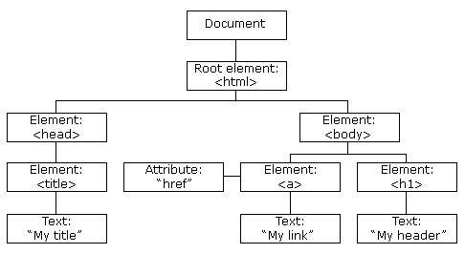

Slide 50
JavaScript can change all the HTML elements in the page
JavaScript can change all the HTML attributes in the page
JavaScript can change all the CSS styles in the page
JavaScript can remove existing HTML elements and attributes
JavaScript can add new HTML elements and attributes
JavaScript can react to all existing HTML events in the page
JavaScript can create new HTML events in the page

Slide 51
The W3C DOM standard is separated into 3 different parts:
Core DOM - standard model for all document types
XML DOM - standard model for XML documents
HTML DOM - standard model for HTML documents

Slide 52
The getElementById Method
The most common way to access an HTML element is to use the id of the element.
In the example above the getElementById method used id="demo" to find the element.

Slide 53
The innerHTML Property
The easiest way to get the content of an element is by using the innerHTML property.
The innerHTML property is useful for getting or replacing the content of HTML elements.

Slide 54
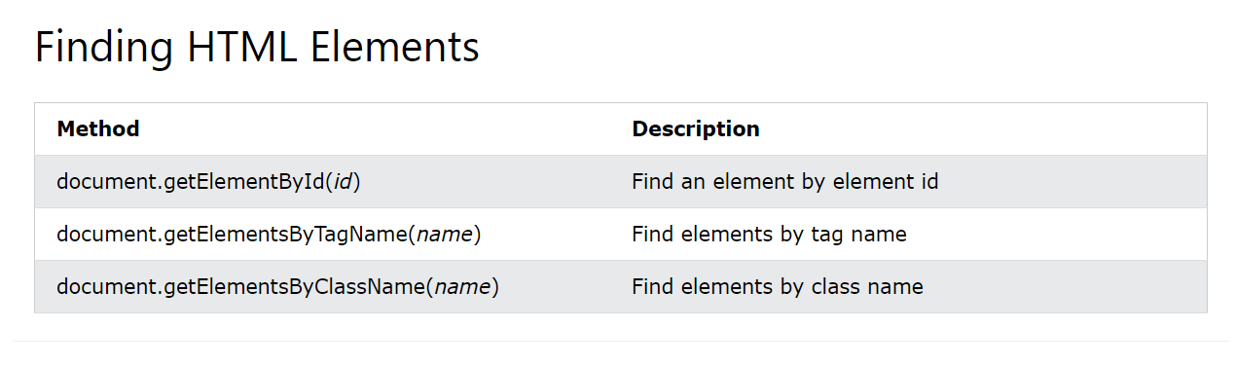

Slide 55
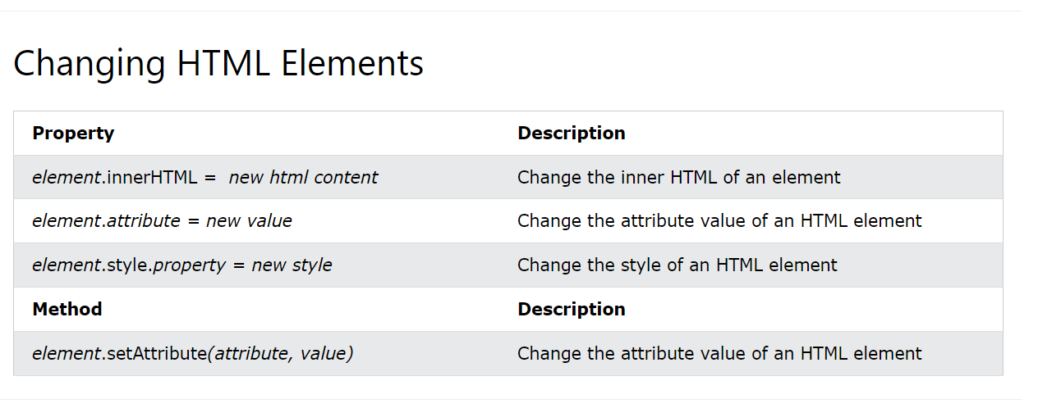

Slide 56
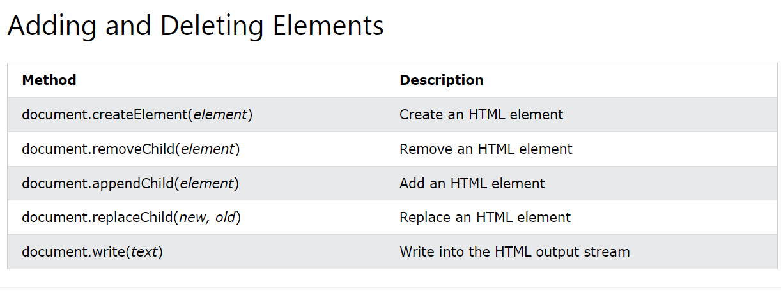

Slide 57
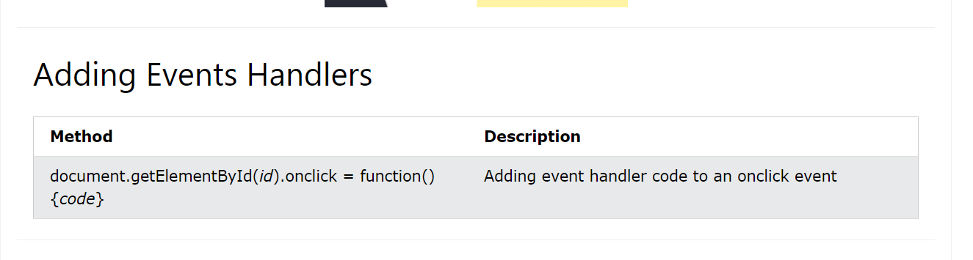

Slide 58
Required
<!DOCTYPE html>
<html>
<body>
<h2>JavaScript Validation</h2>
<form action="/action_page.php" method="post">
<input type="text" name="fname" required>
<input type="submit" value="Submit">
</form>
<p>If you click submit, without filling out the text field,
your browser will display an error message.</p>
</body>
</html>

Slide 59
<!DOCTYPE html>
<html>
<head>
<style>
/* unvisited link */
a:link {
color: red;
}
/* visited link */
a:visited {
color: green;
}
/* mouse over link */
a:hover {
color: hotpink;
}
/* selected link */
a:active {
color: blue;
}
</style>
</head>

Slide 60
Events
<!DOCTYPE html>
<html>
<body>
<h1>JavaScript HTML Events</h1>
<h2>The onclick Attribute</h2>
<h2 onclick="this.innerHTML='Ooops!'">Click on this text!</h2>
</body>
</html>

Slide 61
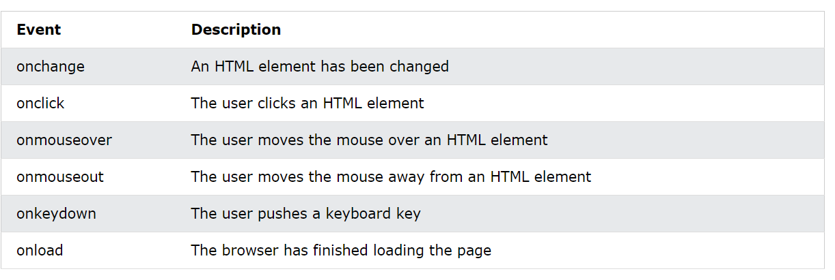

Slide 62
Onclick
<!DOCTYPE html>
<html>
<body>
<h1>JavaScript HTML Events</h1>
<h2>The onclick Attribute</h2>
<h2 onclick="changeText(this)">Click on this text!</h2>
<script>
function changeText(id) {
id.innerHTML = "Ooops!";
}
</script>
</body>
</html>

Slide 63
onmousedown
<!DOCTYPE html>
<html>
<body>
<h1>HTML DOM Events</h1>
<h2>The onmousedown Event</h2>
<p>Clock the text below!</p>
<p id="myP" onmousedown="mouseDown()" onmouseup="mouseUp()">
The mouseDown() function sets the color of this text to red.
The mouseUp() function sets the color of this text to blue.
</p>
<script>
function mouseDown() {
document.getElementById("myP").style.color = "red";
}
function mouseUp() {
document.getElementById("myP").style.color = "blue";
}
</script>
</body>
</html>

Slide 64
Event Listener
<!DOCTYPE html>
<html>
<body>
<h2>JavaScript addEventListener()</h2>
<p>This example uses the addEventListener() method to attach a click event to a button.</p>
<button id="myBtn">Try it</button>
<script>
document.getElementById("myBtn").addEventListener("click", function() {
alert("Hello World!");
});
</script>
</body>
</html>

Slide 65
String Methods

Slide 66
String Length
<!DOCTYPE html>
<html>
<body>
<h1>JavaScript Strings</h1>
<h2>The length Property</h2>
<p>The length of the string is:</p>
<p id="demo"></p>
<script>
let text = "ABCDEFGHIJKLMNOPQRSTUVWXYZ";
document.getElementById("demo").innerHTML = text.length;
</script>
</body>
</html>

Slide 67
<!DOCTYPE html>
<html>
<body>
<h1>JavaScript String</h1>
<h2>The charAt() Method</h2>
<p>The charAt() method returns the character at a given position in a string:</p>
<p id="demo"></p>
<script>
var text = "HELLO WORLD";
document.getElementById("demo").innerHTML = text.charAt(0);
</script>
</body>
</html>

Slide 68
<!DOCTYPE html>
<html>
<body>
<h1>JavaScript Strings</h1>
<h2>The at() Method</h2>
<p>The at() method returns an indexed element from a string:</p>
<p id="demo"></p>
<script>
const name = "W3Schools";
let letter = name.at(2);
document.getElementById("demo").innerHTML = letter;
</script>
</body>
</html>

Slide 69
<!DOCTYPE html>
<html>
<body>
<h1>JavaScript Strings</h1>
<h2>The lastIndexOf() Method</h2>
<p>The position of the last occurrence of "locate" is:</p>
<p id="demo"></p>
<script>
let text = "Please le";
let index = text.lastIndexOf("le");
document.getElementById("demo").innerHTML = index;
</script>
</body>
</html>

Slide 70
Array
<!DOCTYPE html>
<html>
<body>
<h1>JavaScript Arrays</h1>
<p id="demo"></p>
<script>
const cars = ["Saab", "Volvo", "BMW"];
document.getElementById("demo").innerHTML = cars;
</script>
</body>
</html>

Slide 71
LOOP
<!DOCTYPE html>
<html>
<body>
<h2>JavaScript For Loop</h2>
<p id="demo"></p>
<script>
const cars = ["BMW", "Volvo", "Saab", "Ford", "Fiat", "Audi"];
let text = "";
for (let i = 0; i < cars.length; i++) {
text += cars[i] + "<br>";
}
document.getElementById("demo").innerHTML = text;
</script>
</body>
</html>

Slide 72
Reset
<!DOCTYPE html>
<html>
<body>
<p>Enter some text in the fields below, then press the "Reset form" button to reset the form.</p>
<form id="myForm">
First name: <input type="text" name="fname"><br>
Last name: <input type="text" name="lname"><br><br>
<input type="button" onclick="myFunction()" value="Reset form">
</form>
<script>
function myFunction() {
document.getElementById("myForm").reset();
}
</script>
</body>
</html>

Slide 73
Object Data Type
<!DOCTYPE html>
<html>
<body>
<h1>JavaScript Objects</h1>
<h2>Creating an Object</h2>
<p id="demo"></p>
<script>
// Create an Object:
const car = {type:"Fiat", model:"500", color:"white"};
// Display Data from the Object:
document.getElementById("demo").innerHTML =
"The car type is " + car.type;
</script>
</body>
</html>

Slide 74
Object Properties
<!DOCTYPE html>
<html>
<body>
<h1>JavaScript Object Properties</h1>
<h2>Access a Property with .</h2>
<p id="demo"></p>
<script>
const person = {
firstname: "John",
lastname: "Doe",
age: 50,
eyecolor: "blue"
};
document.getElementById("demo").innerHTML = person.firstname + " is " + person.age + " years old.";
</script>
</body>
</html>

Slide 75
This Variable
<!DOCTYPE html>
<html>
<body>
<h1>JavaScript Objects</h1>
<h2>Object Methods</h2>
<p>A method is a function definition stored as a property value.</p>
<p id="demo"></p>
<script>
const person = {
firstName: "John",
lastName: "Doe",
id: 5566,
fullName: function() {
return this.firstName + " " + this.lastName;
}
};
document.getElementById("demo").innerHTML = person.fullName();
</script>
</body>
</html>

Slide 76
String
<!DOCTYPE html>
<html>
<body>
<h1>JavaScript Strings</h1>
<h2>The length Property</h2>
<p>The length of the string is:</p>
<p id="demo"></p>
<script>
let text = "ABCDEFGHIJKLMNOPQRSTUVWXYZ";
document.getElementById("demo").innerHTML = text.length;
</script>
</body>
</html>

Slide 77
CharCode
<!DOCTYPE html>
<html>
<body>
<h1>JavaScript String</h1>
<h2>The charCodeAt() Method</h2>
<p>The charCodeAt() method returns the unicode of the character at a given position in a string:</p>
<p id="demo"></p>
<script>
let text = "AELLO WORLD";
document.getElementById("demo").innerHTML = text.charCodeAt(0);
</script>
</body>
</html>

Slide 78
At Method
<!DOCTYPE html>
<html>
<body>
<h1>JavaScript Strings</h1>
<h2>The at() Method</h2>
<p>The at() method returns an indexed element from a string:</p>
<p id="demo"></p>
<script>
const name = "W3Schools";
let letter = name.at(2);
document.getElementById("demo").innerHTML = letter;
</script>
</body>
</html>

Slide 79
Index Of Method
<!DOCTYPE html>
<html>
<body>
<h1>JavaScript Strings</h1>
<h2>The indexOf() Method</h2>
<p>The indexOf() method returns the position of the first occurrence of a string in a string.</p>
<p>The position of the first occurrence of "locate" is:</p>
<p id="demo"></p>
<script>
let text = "Please locate where 'locate' occurs!";
let index = text.indexOf("locate");
document.getElementById("demo").innerHTML = index;
</script>
</body>
</html>

Slide 80
Last Index Of
<!DOCTYPE html>
<html>
<body>
<h1>JavaScript Strings</h1>
<h2>The lastIndexOf() Method</h2>
<p>The position of the last occurrence of "locate" is:</p>
<p id="demo"></p>
<script>
let text = "Please locate where 'locate' occurs!";
let index = text.lastIndexOf("locate");
document.getElementById("demo").innerHTML = index;
</script>
</body>
</html>

Slide 81
Declare the following array and print only multiples of 3 from it.
[100,6767,989,26,299,89,7,16,12.14]
Declare the following array and print only odd numbers from it. Sort this array, reverse it, add element 67, and remove element 67.
[3,12,45,43,45,78,89,23,22,19,18,17,16,12.14]
Print all the prime numbers between 3 and 128
Create an object Student, add properties First Name, Middle Name , last Name , Age , Gender. Print the line : My name is First Name Middle Name. My age is Age. My Gender is Gender.
Declare a string ”AEROSPACE Engineering from Amity University Bengaluru”, do the following:
find its length
find char code of E
Find Element at Index 9
Find index of Bengaluru

Slide 82
AutoFocus
<!DOCTYPE html>
<html>
<body>
Password: <input type="password" id="myPsw" autofocus>
<p>Click the button to find out if the password field automatically gets focus when the page loads.</p>
<button onclick="myFunction()">Try it</button>
<p id="demo"></p>
<script>
function myFunction() {
var x = document.getElementById("myPsw").autofocus;
document.getElementById("demo").innerHTML = x;
}
</script>
</body>
</html>

Slide 83
<!DOCTYPE html>
<html>
<body>
<button onclick="myFunction()">Try it</button>
<script>
function myFunction() {
var x = document.createElement("INPUT");
x.setAttribute("type", "text");
x.setAttribute("value", "Hello World!");
document.body.appendChild(x);
}
</script>
</body>
</html>

Slide 84
Disable
<!DOCTYPE html>
<html>
<body>
Password: <input type="password" id="myPsw">
<p>Click the button to disable the password field.</p>
<button onclick="myFunction()">Try it</button>
<script>
function myFunction() {
document.getElementById("myPsw").disabled = true;
}
</script>
</body>
</html>

Slide 85
1.Write a program, to get two number boxes and Three Buttons on a webpage.
On Click of Button 1: The Largest of Two Numbers should be displayed
Onclick of Button 2: Prime Numbers Between those Numbers should Be Displayed
2.Using Switch Case Statement for grades ('A', 'B', 'C', 'D', 'F') and correspondingly returns the corresponding description ("Excellent", "Good", "Average", "Poor", "Fail").
3.Using Switch Case write a program that takes a number from 0 to 6 and returns "Weekend" for 0 (Sunday) and 6 (Saturday), and "Weekday" for the other days (1 to 5).
4.Write a while loop that sums the numbers from 1 to 100 and prints the result.
5.Given an array of numbers, write a while loop to find and print the first number greater than 50.

